Slide 1
The boy behind the label
By Max Knox
A redesign of Raised On Ritalin by Tyler Page

Slide 2
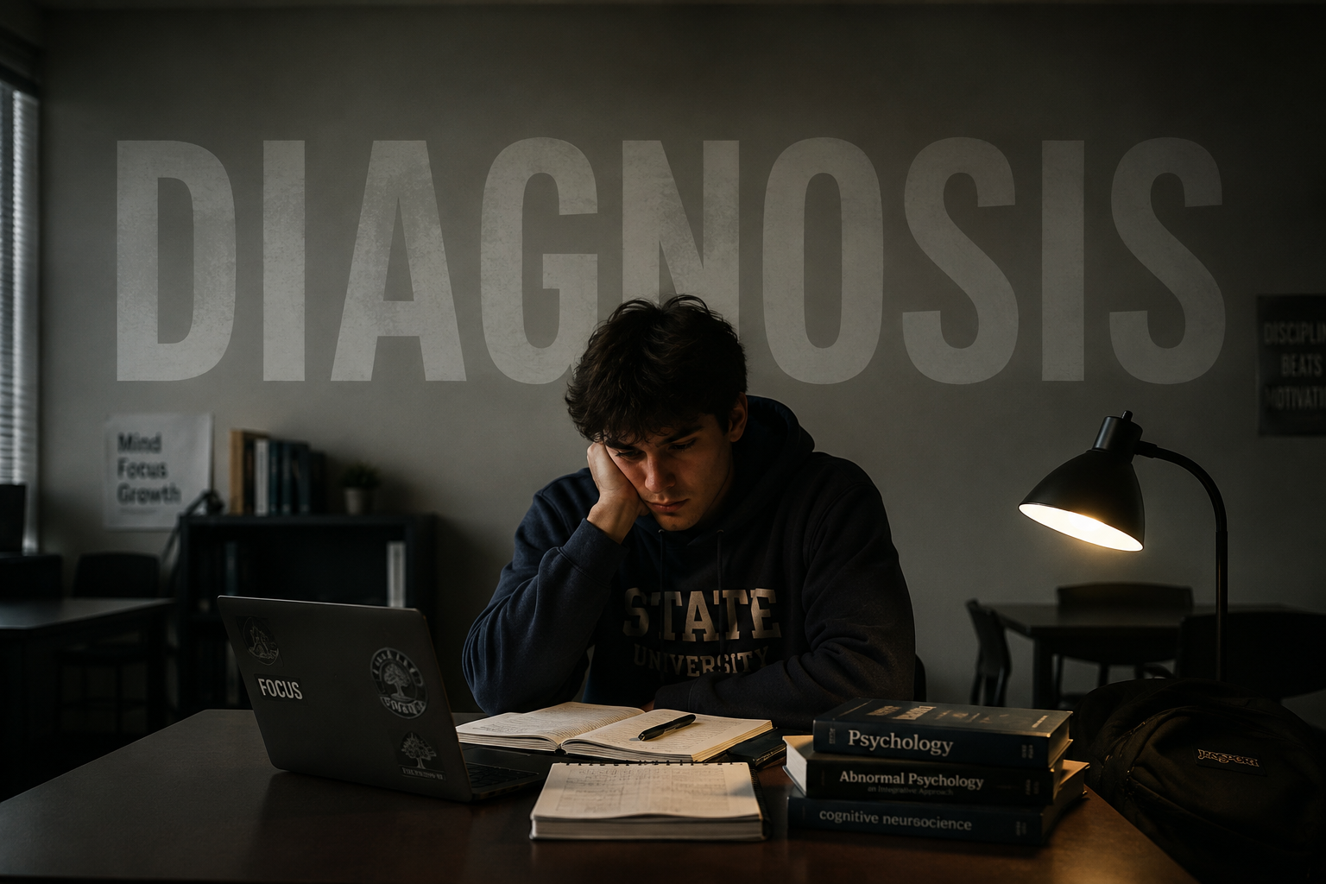
Alex is a ten-year-old student who often finds himself in trouble at school. He isn't unintelligent or lazy, in fact, he's incredibly curious and imaginative. But his mind seems to move faster than the classroom around him. While the other students are working quietly, Alex is looking out the window, drawing in the margins of his notebook, or thinking about a completely different question.

Slide 3

Alex has always been different from the other students. He forgets homework, loses pencils, interrupts conversations, and struggles to sit still for long periods of time. His teachers become frustrated and begin to believe that Alex simply isn't trying hard enough. At home, his parents hear the same complaints again and again, and they begin wondering if something deeper is going on.

Slide 4
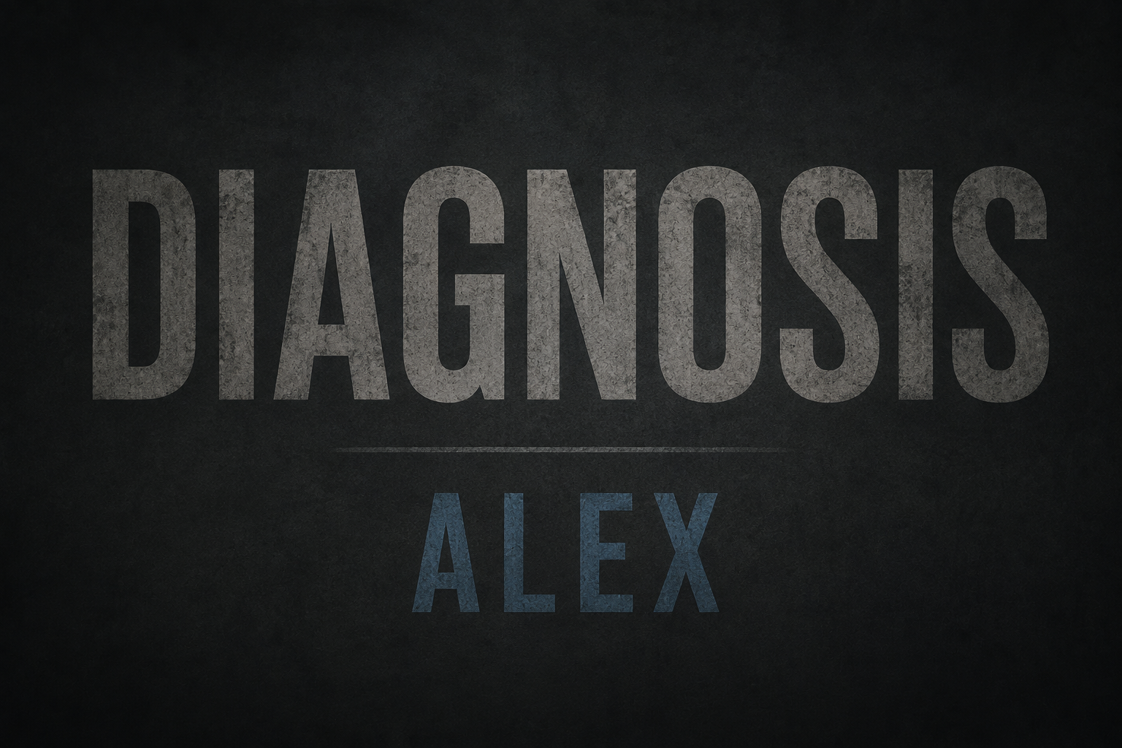
Eventually, Alex is taken to a professional for an evaluation and receives a diagnosis related to attention. His parents feel relieved because they finally have an explanation for his struggles. But Alex doesn't completely understand what the diagnosis means. All he hears is that there is something about him that needs to be fixed. For the first time, he begins wondering if there is something wrong with who he is.

Slide 5
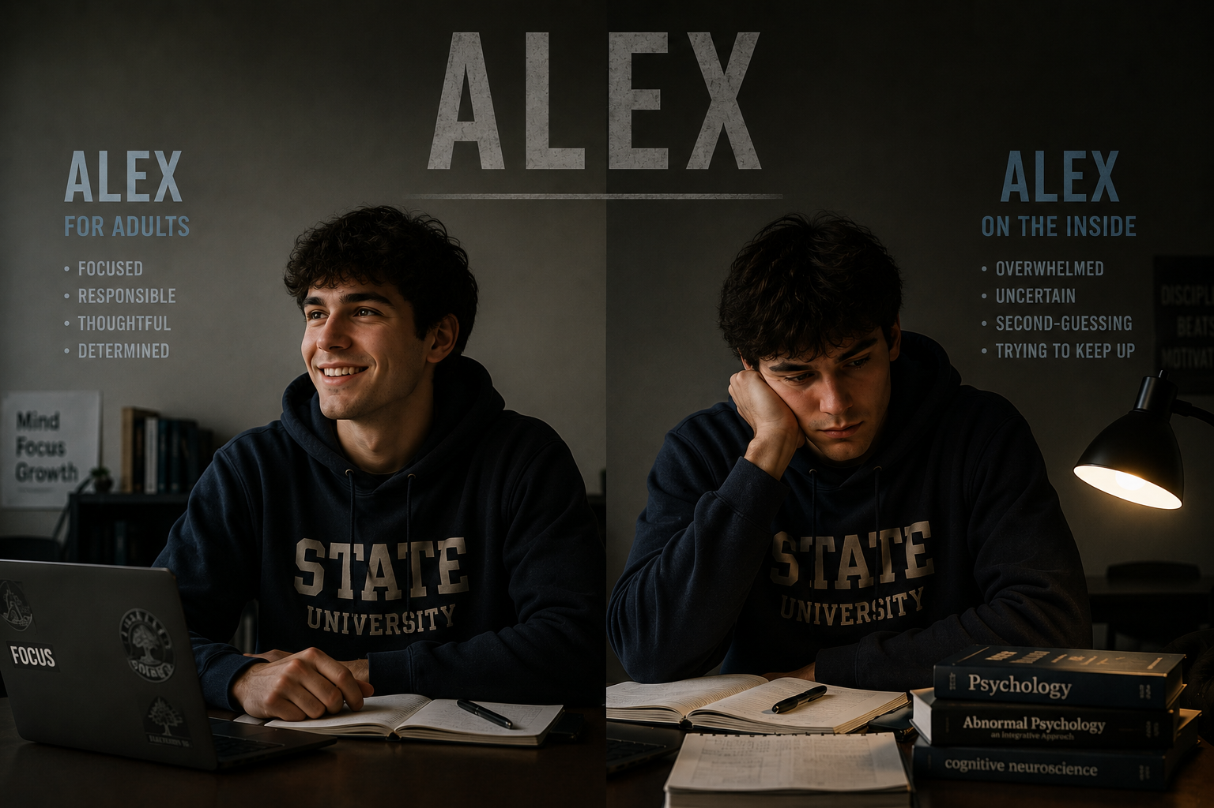
Alex begins a new treatment routine, and at first, everyone seems happy with the results. He receives fewer behavior warnings, finishes more assignments, and his teachers praise him for being focused. His parents are relieved too. But Alex notices something they don't. Although he is getting better grades and causing fewer problems, he doesn't always feel like himself. It makes him wonder whether the treatment is helping him—or simply making him easier for everyone else to manage.

Slide 6
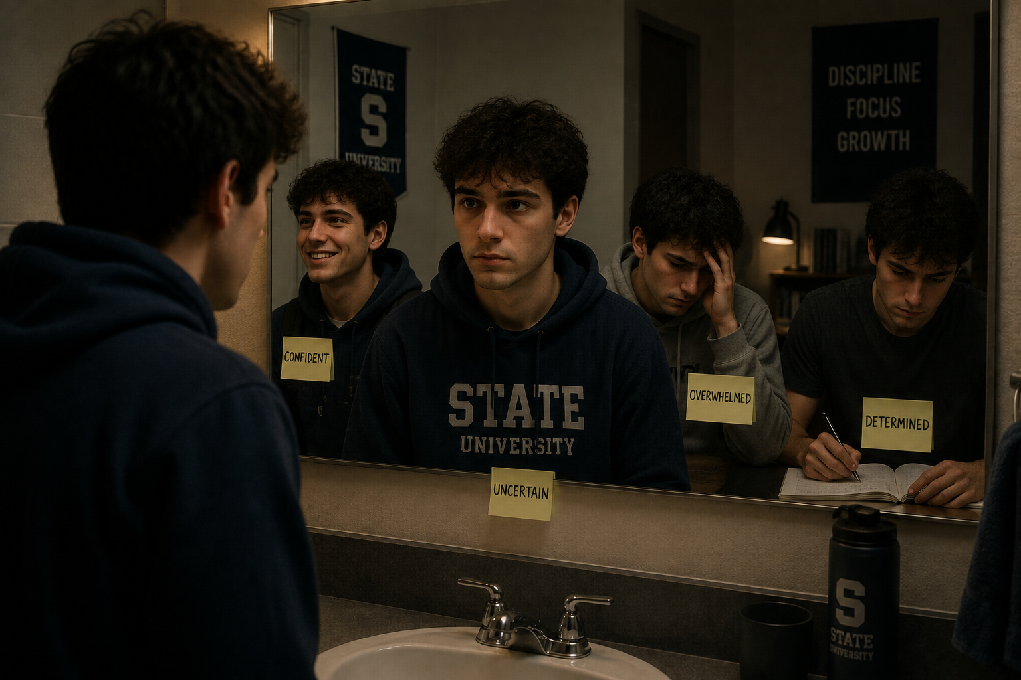
As the months go by, Alex begins asking himself questions that he doesn't know how to answer. Is being distracted always a bad thing? Is being energetic a problem? What if the parts of himself that adults want to change are also the parts that make him creative? Alex starts to realize that nobody has really asked him how he feels about everything happening to him.

Slide 7
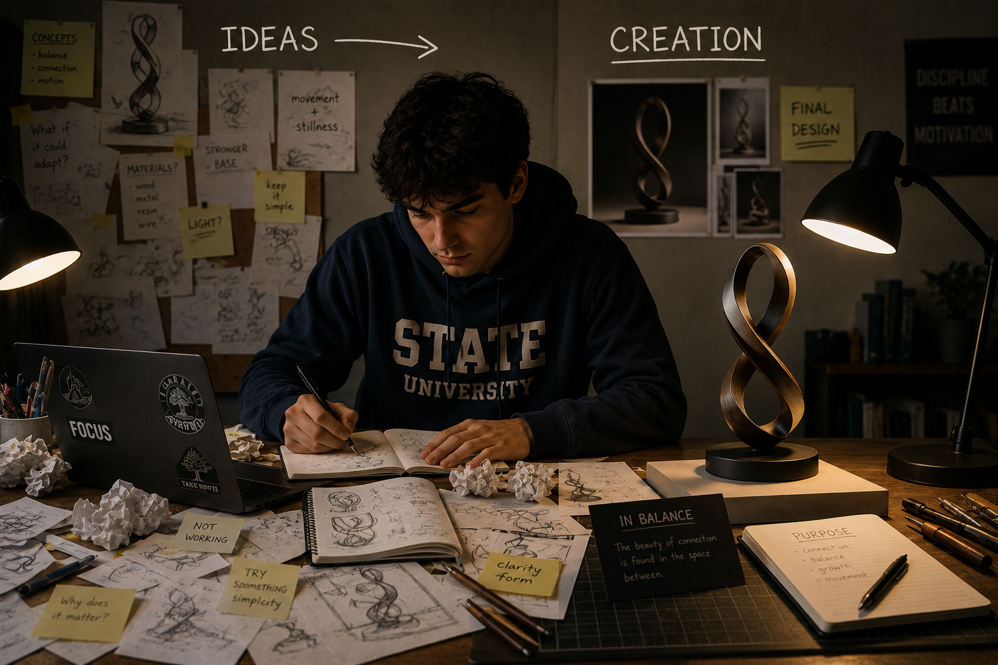
One day, Alex's class is given a creative assignment. Instead of following the instructions exactly, Alex approaches the problem in a completely unexpected way. At first, his teacher thinks he has misunderstood the assignment. But then she realizes that Alex has found a solution nobody else thought of. For the first time, Alex sees that the way his mind works isn't always a weakness. Sometimes, seeing the world differently can be a strength.

Slide 8
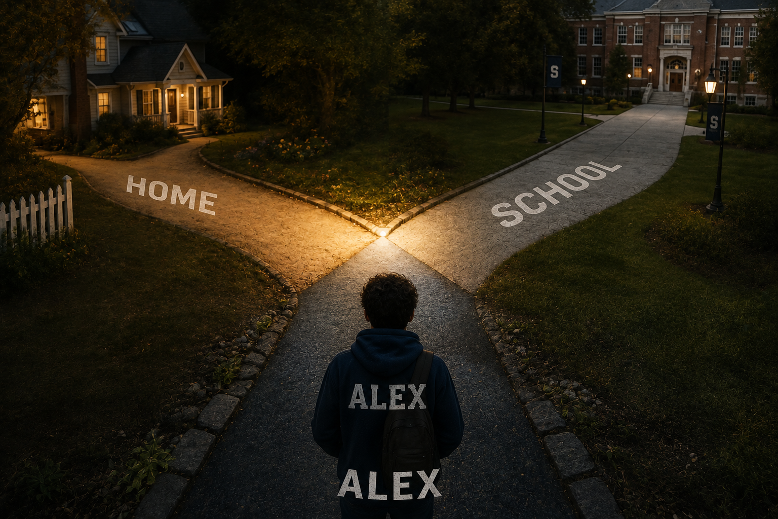
Alex's parents begin thinking about their own expectations. They realize that they have spent a lot of time asking how they could make Alex behave differently, but not enough time asking what Alex actually needed. Instead of focusing only on changing him, they begin looking for ways to change his environment and support his strengths. They talk with Alex and his teachers and make him part of the decisions about his future.

Slide 9

Alex slowly learns that having difficulties doesn't mean he is incapable. He can need help with some things while being exceptionally good at others. His diagnosis becomes something that helps explain certain challenges rather than a label that defines his entire personality. Most importantly, Alex finally understands that his opinion matters. He isn't simply someone being evaluated, treated, or corrected, he is part of his own story.

Slide 10

Several years later, Alex looks back at a photograph of himself sitting alone at his childhood desk. He remembers how strongly he once believed that something was wrong with him. Now, he sees the situation differently. His childhood wasn't a story about being broken. It was a story about learning how his mind works, discovering what environments help him succeed, and understanding that needing support doesn't make someone less capable.

Slide 11

Alex's story ends with him walking away from the label that once seemed to define him. He hasn't forgotten his struggles, and he doesn't pretend that everything is easy. Instead, he understands that a diagnosis can be useful without becoming someone's identity. The important question isn't simply, “What's wrong with this person?” It is, “Who is this person, what do they need, and what can they become?” A label can describe part of a person, but it can never tell the whole story.

